Slide 1

IBM HR Analytics Employee Attrition & Performance
By Ruyan Aljohani

Slide 2

Introduction
IBM HR Analytics Employee Attrition Performance dataset you will can identifying employees with the highest retention risk or who might be highly targeted for poaching, identifying the assessment of retention risk, and avoid the high cost associated with hiring and training new employees.

Slide 3

Dataset
IBM HR Analytics Employee Attrition & Performance dataset is used. This dataset contains standard HR features such as age, education, gender and rate. It consists of a total of 1470 observations with 35 different attributes. I target attrition feature.

Slide 4
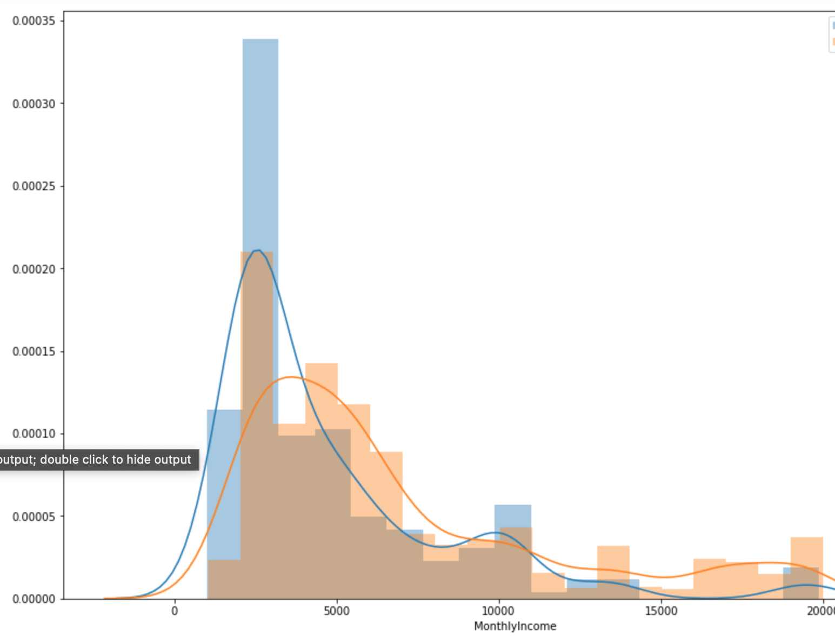
Data Visualization
Plot shows employees who's get less monthly income are more likely to leave

Slide 5
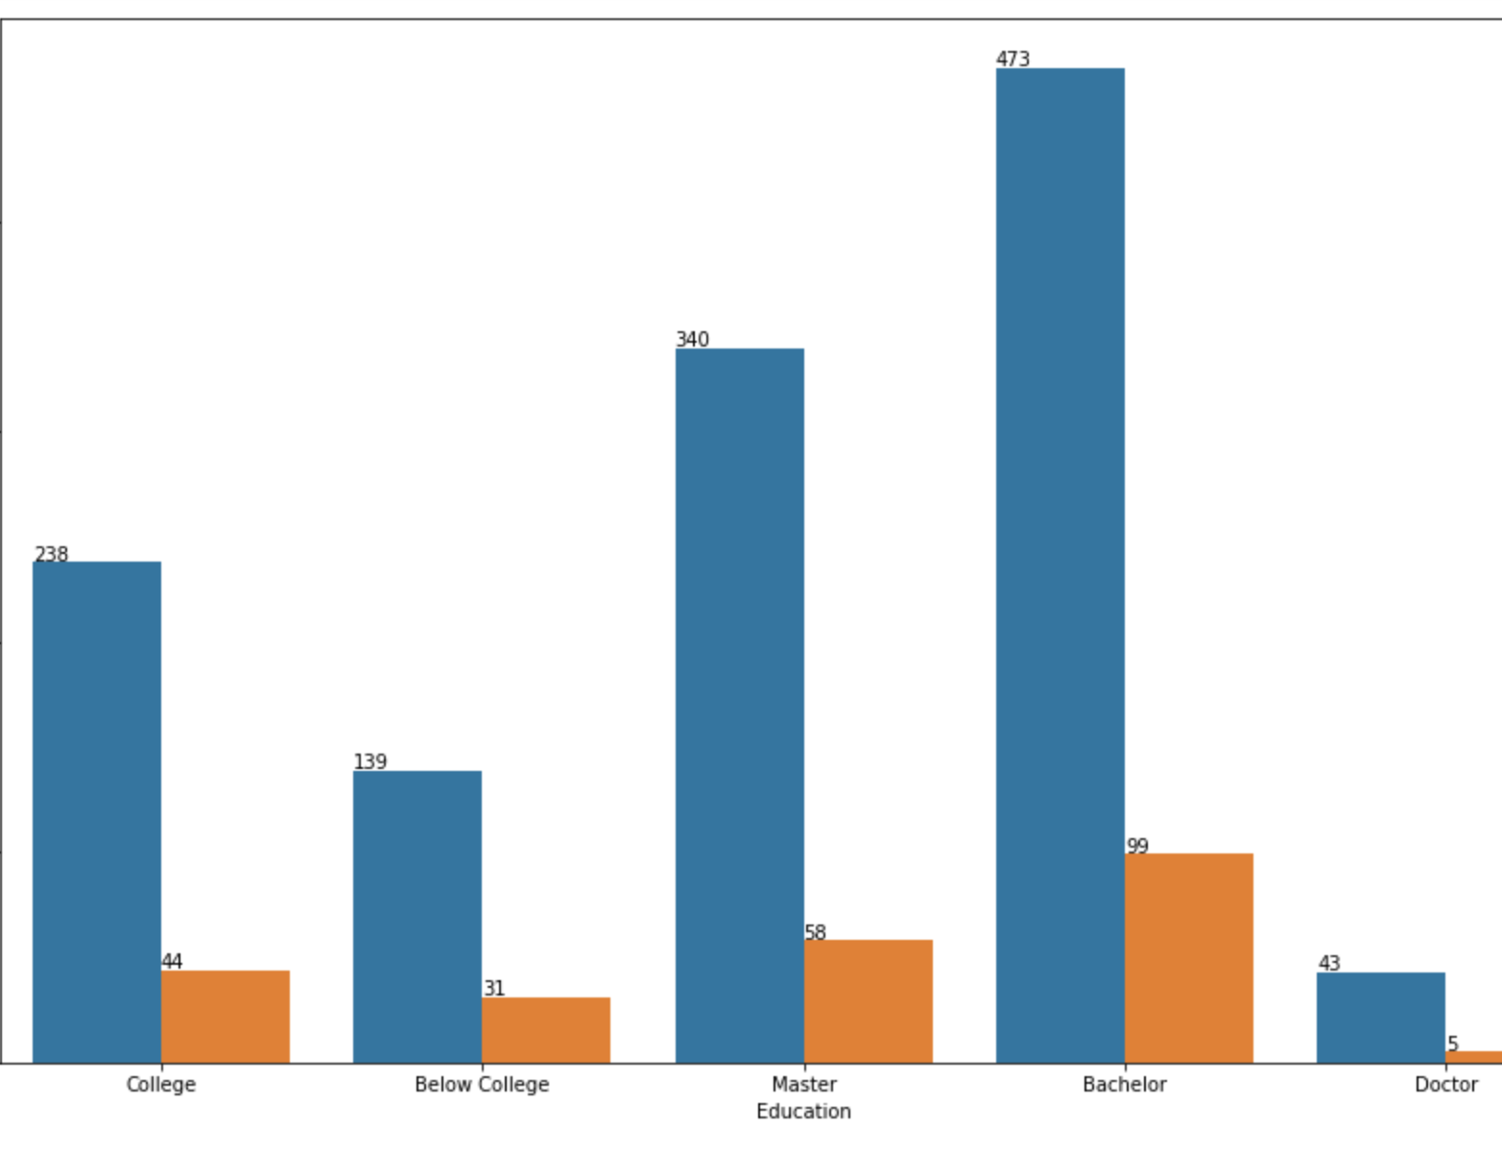
Data Visualization
Most of employee who have Bachelor degree are more likely to quit then the employee with Master degree

Slide 6
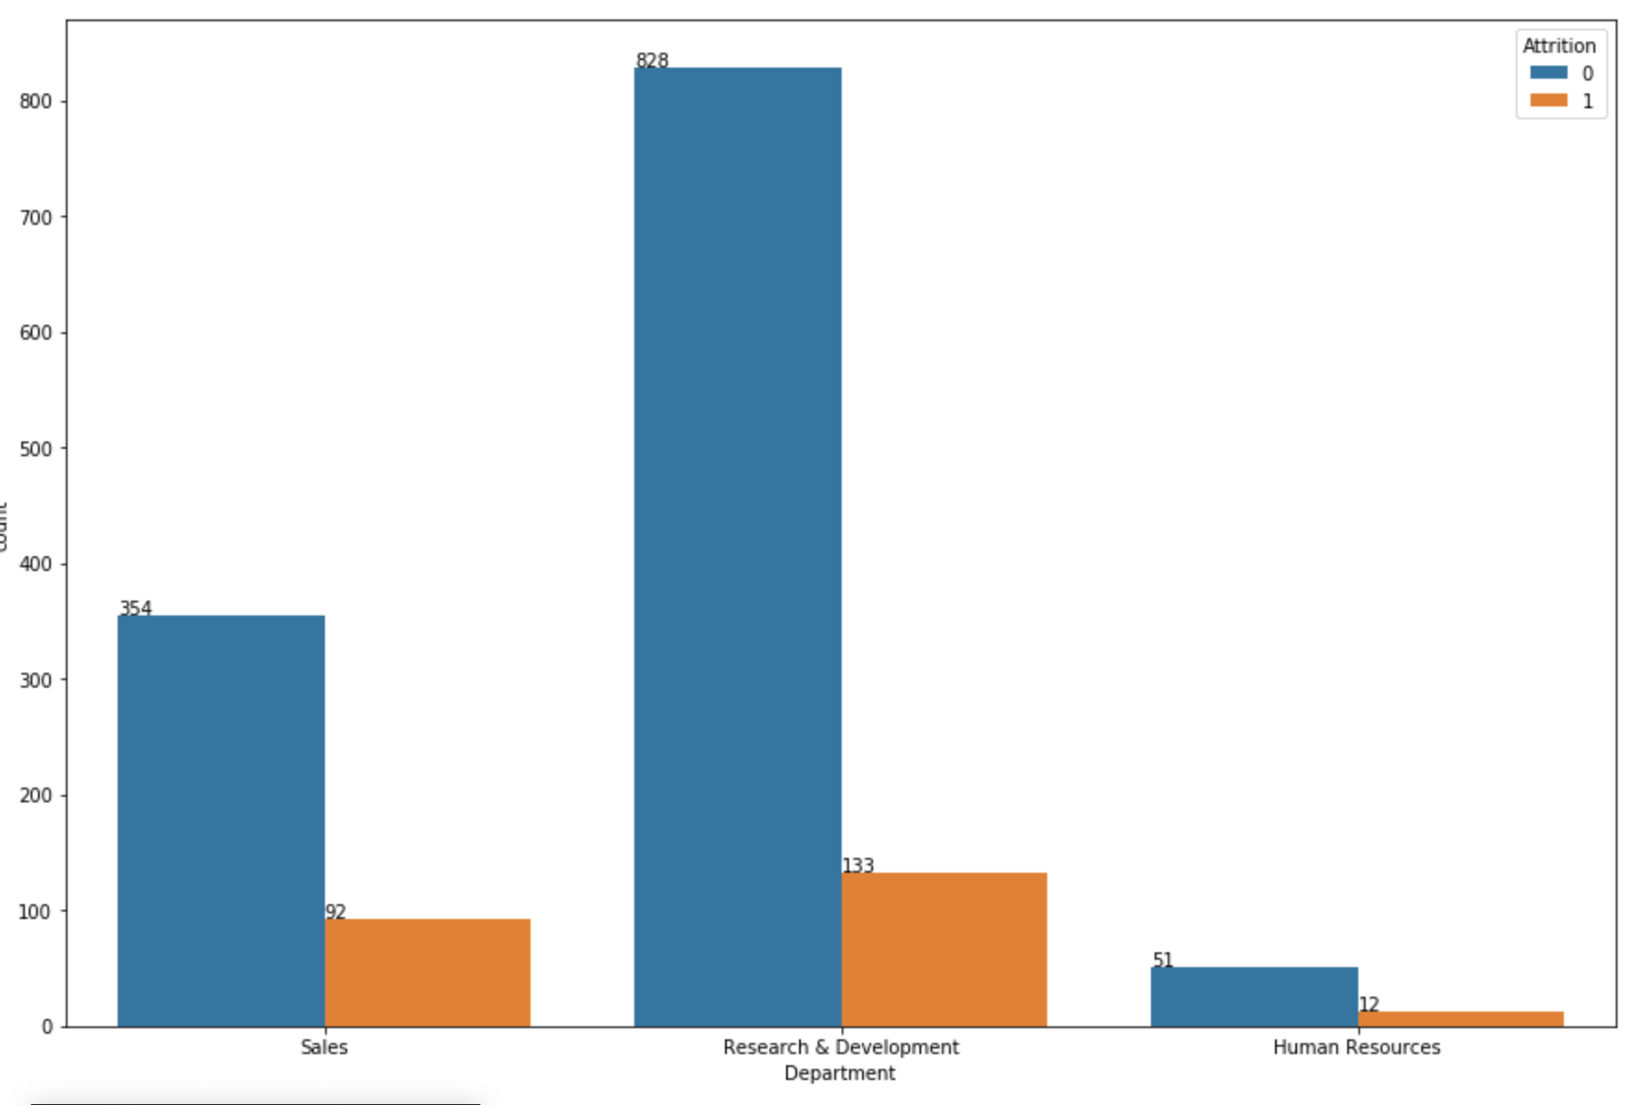
Data Visualization
The plot shows the employess from research and development department are likely to quit then the sales depatment

Slide 7

Data processing
Convert label data to numeric
Dose not contain null values
Drop 4 irrelevant columns, i.e:EmployeeCount, EmployeeNumber, Over18 and StandardHour. So, we have to remove these for more accuracy.

Slide 8
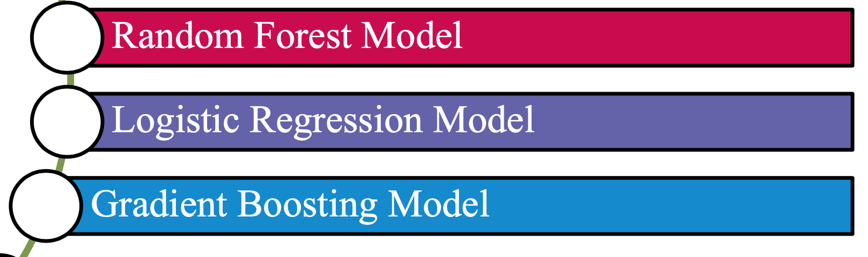
Models used and the result on train test

Slide 9
Accuracy result on train test
Logistic Regression
0.65%
Gradient Boosting Accuracy
0.82
Random Forest
0.76%

Slide 10
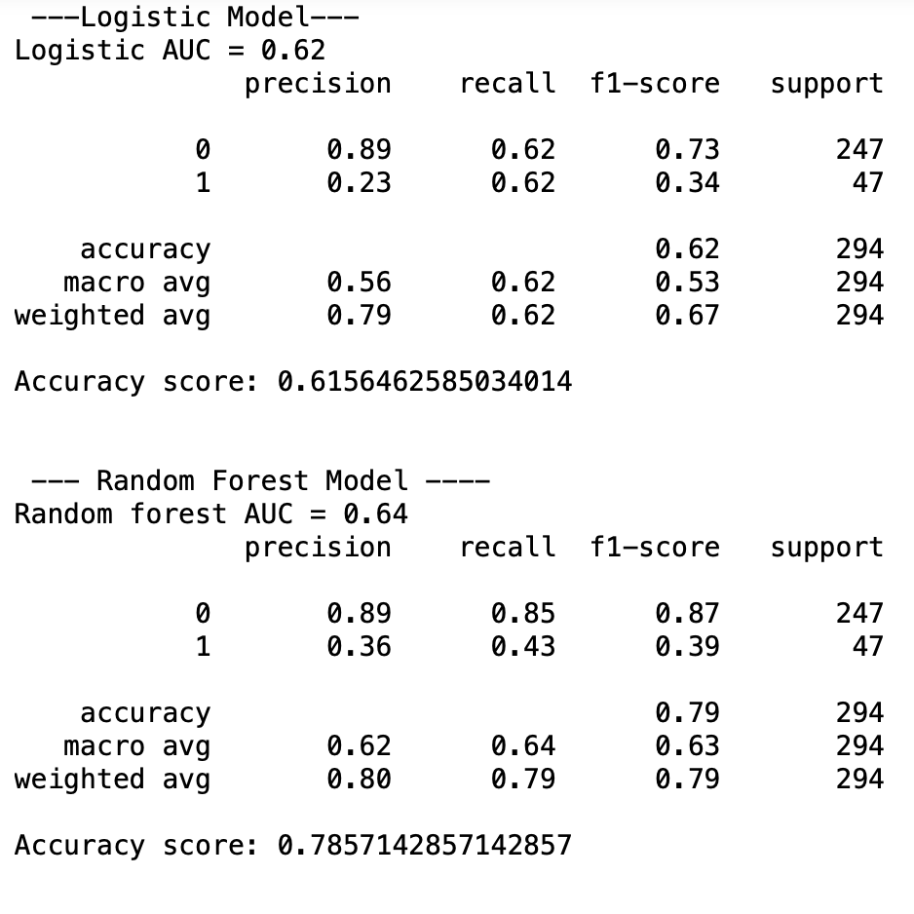
Result on test set

Slide 11
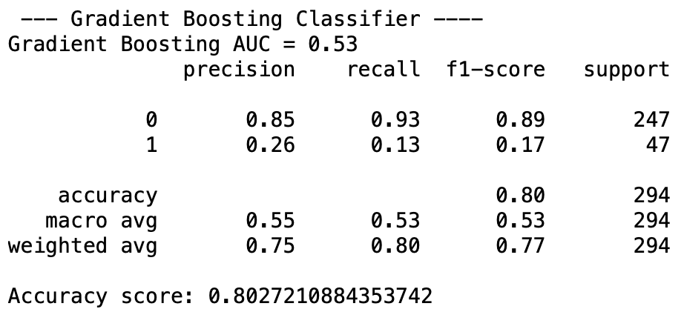
Result on test set
The Gradient Boosting has the best Accuracy and best performance.

Slide 12
Future Work
I believe that a higher rate can be reached at the level of the train set and the test set if we tried to work on the different model’s combinations that have similarities in the universe or have some significant hyperparameters

Slide 13
Thank you for listening

